Slide 1
APPLICATION LAYER

Slide 2
Application Protocols covered till date:
SMTP : Simple Mail Transfer Protocol
POP : Post Office Protocol
IMAP : Internet Message Access Protocol
MIME : Multipurpose Internet Mail Extensions
HTTP : HyperText Transport Protocol
TELNET : TErminaL Network Protocol
SSH : Secure Shell Protocol
FTP: File Transfer Protocol
DNS: Domain Name System
SNMP: Simple Network Management Protocol

Slide 3
Web Applications
Email
WWW
BitTorrent
Skype
And so on..

Slide 4


EMAIL

Slide 5
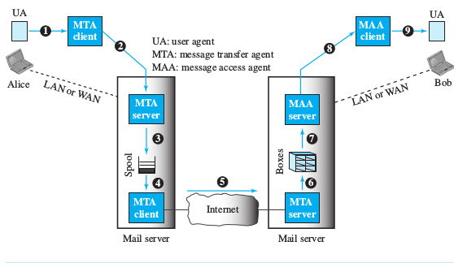
Email
Email System :
Architecture

Slide 6
Three main components:
User Agents
Message Transfer Agent
Message Access Agent

Slide 7
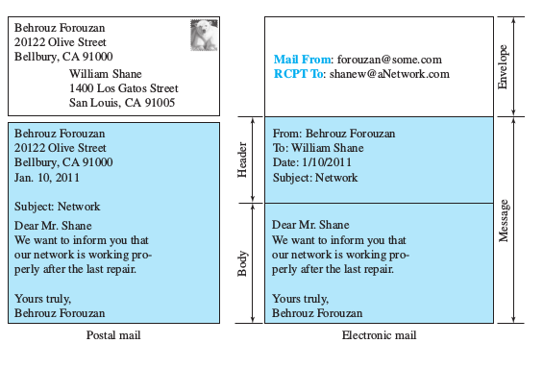
Format of an e-mail

Slide 8
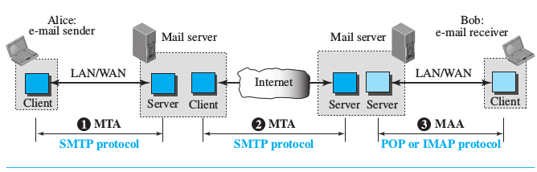
Protocols used in e-mail

Slide 9
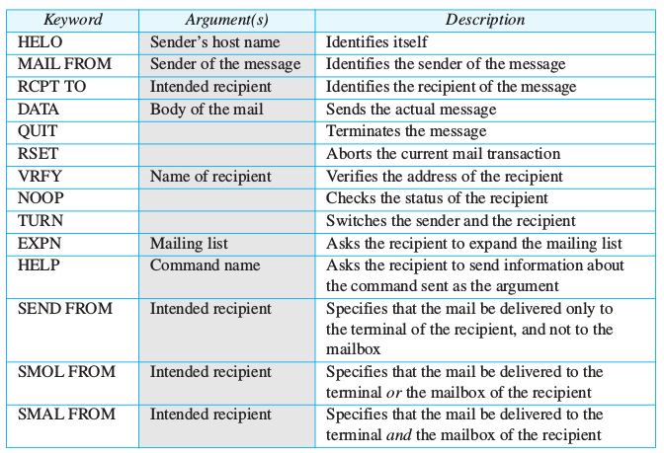
SMTP: Simple Mail Transfer Protocol
Commands:

Slide 10
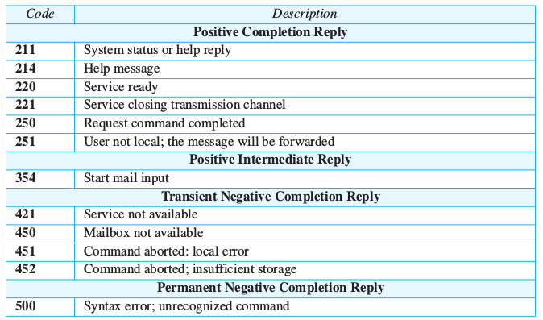
SMTP Responses

Slide 11
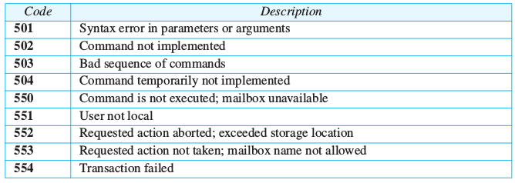
SMTP Responses

Slide 12
Mail Transfer Phases
Connection Establishment
Message Transfer
Connection Termination

Slide 13
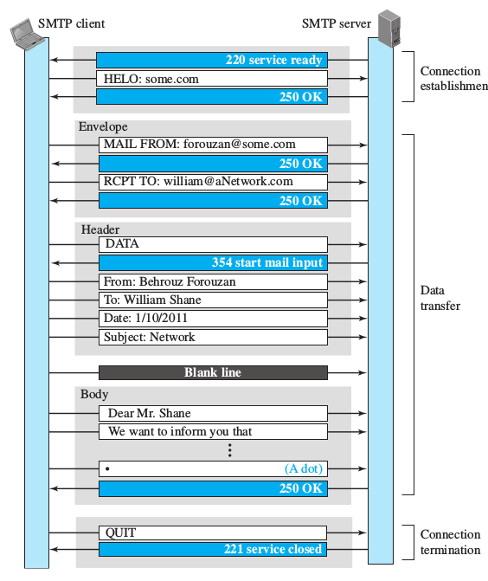

Slide 14
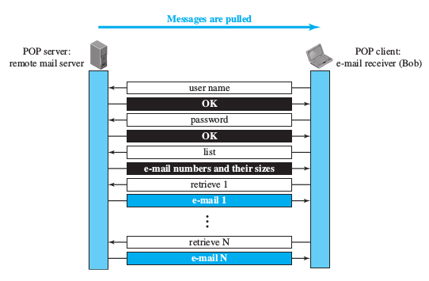
Message Access Agent: POP and IMAP
POP3 :
Post Office Protocol

Slide 15
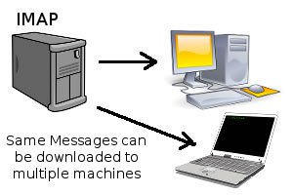
IMAP4 : Internet Message Access Protocol

Slide 16
MIME: Multipurpose Internet Mail Extensions
Limitations of e-mail:
It cannot be used for languages other than English.
It cannot send binary files or video or audio.
So MIME is a companion protocol for defining format of the email message.
It allows non-ASCII data to be sent through e-mail.

Slide 17
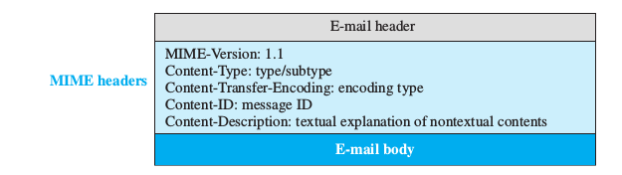
MIME Headers

Slide 18
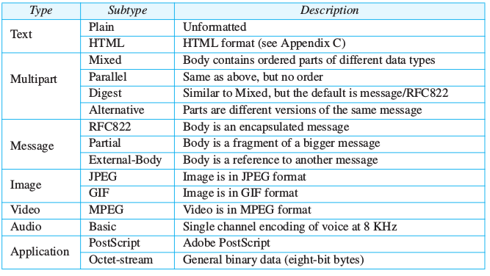
MIME Content Type

Slide 19
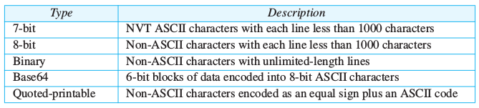
Content Transfer Encoding

Slide 20
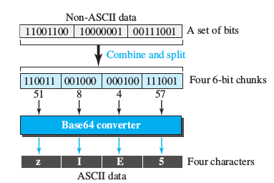
Example of Base64 conversion

Slide 21
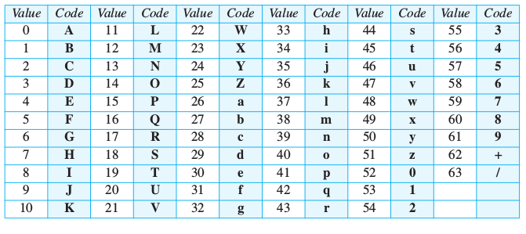
Base64 Converting Table

Slide 22
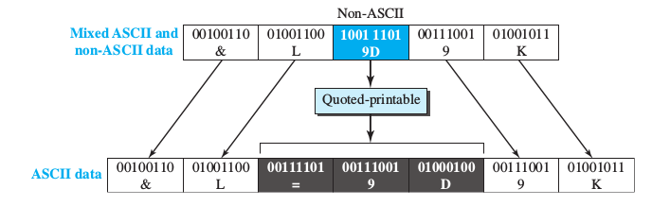
Quoted Printable encoding example:

Slide 23
GATE 2019
Which of the following protocol pairs can be used to send and retrieve e-mails (in that order)?
A ) IMAP POP3
B ) SMTP, POP3
C ) SMTP, MIME
D ) IMAP, SMTP

Slide 24

WWW : World Wide Web
WWW is a well known web service provided by the Internet.
It is a repository of information.
HTTP is a application layer protocol to retrieve information from the Web

Slide 25

WWW and HTTP
Web has a set of clients and servers.
They speak a common language : HTTP
How do you access Web?
What is URL?
Web page and Web site?
Domain?
Hypertext?
Hypermedia?

Slide 26
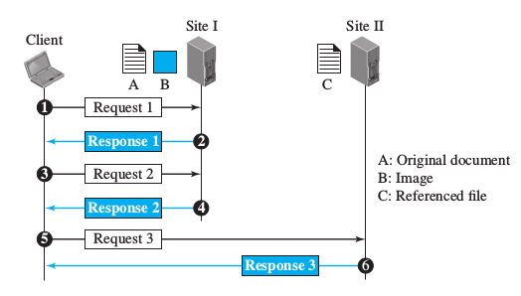
WWW Architecture:

Slide 27
HyperText Transfer Protocol : HTTP
It is a text oriented protocol that has a general format.
It is a stateless application protocol.
Runs over TCP.
Three parts to understand : HyperText, Transfer, Protocol.
It defines how client server programs can be written to retrieve web pages from the web.
HTTP messages are read and interpreted by the HTTP client and Servers.

Slide 28
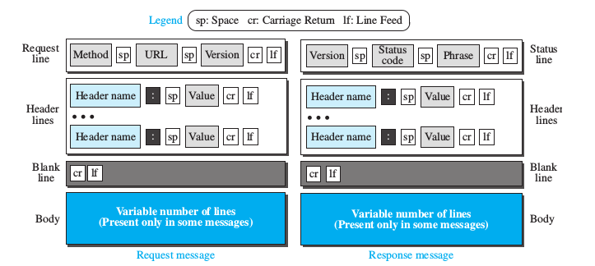
Request and Response message formats:

Slide 29
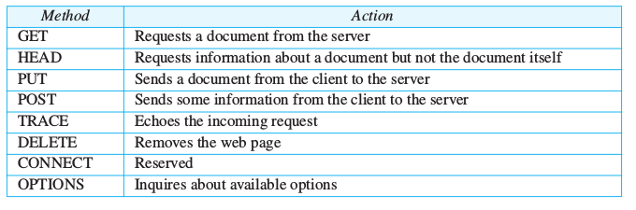
Request Message
Request Line : Method, URL and Version

Slide 30
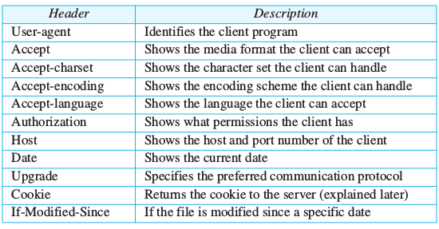
Request Message
Request Header:

Slide 31
Response Message
Status Line: Version, Status code and Status Phrase.
Version is HTTP version : 1.1 or 2.0
Status code: 100 range, 200 range, 300 range, 400 range, 500 range

Slide 32
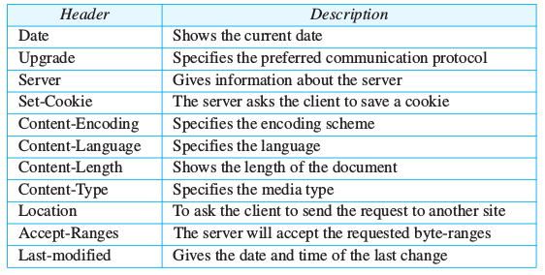
Response Message
Response Header:

Slide 33
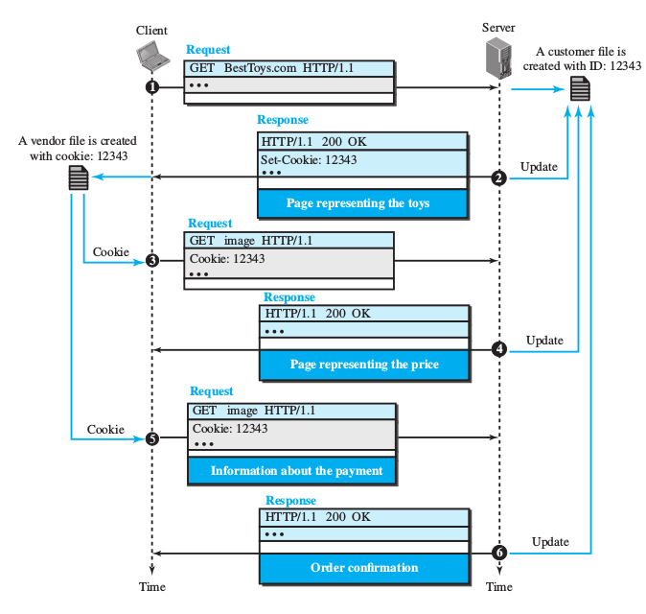

Slide 34
REMOTE LOGGING
TELNET
SSH

Slide 35
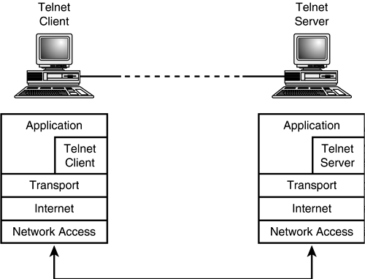
TELNET : TErminaL NETwork
Allows Remote logging
Original protocol for remote login
But now replaced by SSH (not fully)
Problem : no encryption of data

Slide 36
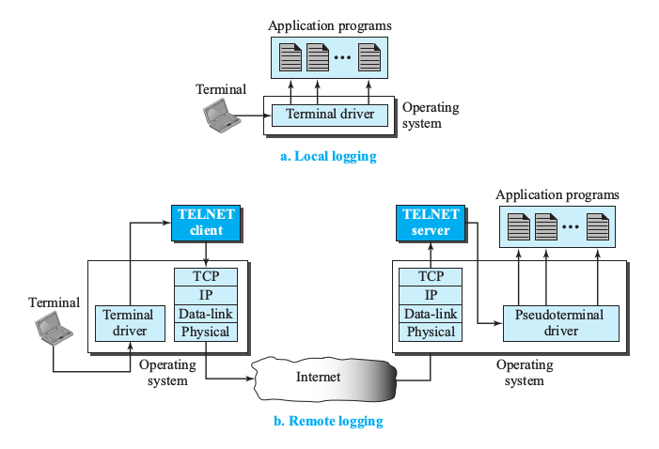
TELNET: Working

Slide 37
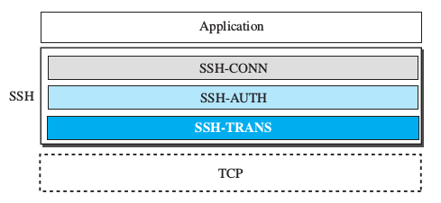
SSH: Secure Shell
It is a secure application layer protocol
It has three main components:
SSH Transport Layer Protocol
SSH Authentication Protocol
SSH Connection Protocol
Applications :
Remote logging
Port Forwarding

Slide 38
FILE TRANSFER PROTOCOL
File Transfer means copying, retrieving or directory listing.
Major concern is Heterogeneity : file type, file system, data representation
It has three major components :
User Interface
Control Process
Data Transfer Process

Slide 39
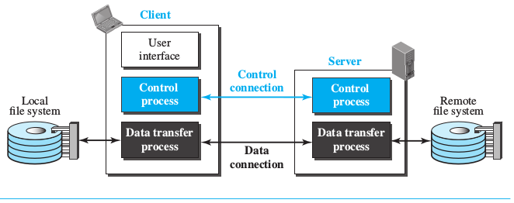
FTP components:

Slide 40
Control Connection
Sending Commands and Receiving Responses
Example for Commands : MKD directory_name --> Creates a directory
DELE filename -- > Deletes a file
MODE S/B/C -- > Transmission mode
Responses : 3 digit followed by description
Example : 125 Data connection open
425 Cannot open data connection

Slide 41
Communication
Three attributes to be specified:
File Type : ASCII, EBCDIC, Image
Data Structure : File, Record, Page
Transmission mode : Stream, Block, Compressed

Slide 42
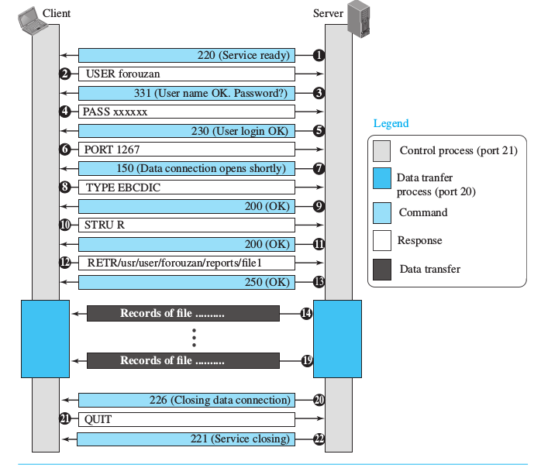

Slide 43
Name Service (Domain Name Server)
Goal is to convert user-friendly names (of hosts in network) into router-friendly addresses.
Name services can be called middleware (between applications and underlying network)
DNS is a supporting program that is used by other programs such as e-mail.
When Internet was small, host name and address were stored in a text file named HOSTS.txt.
National Information Centre (NIC) maintained HOSTS.txt.
As the Internet started to grow, DNS came into play.

Slide 44
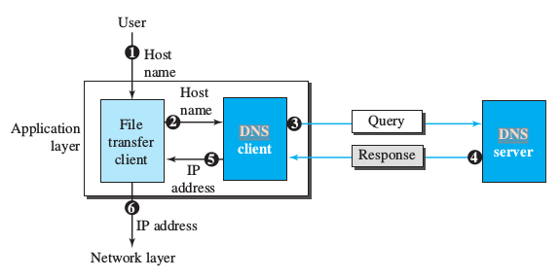
DNS : Working

Slide 45
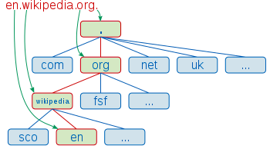
Domain Name Space
NAME SPACE:
FLAT
Hierarchical
DNS implements a hierarchical namespace for Internet Objects.
DNS hierarchy can be visualized as a tree.
Nodes in the tree are Domain
Leaves in the tree are hosts being named.

Slide 46
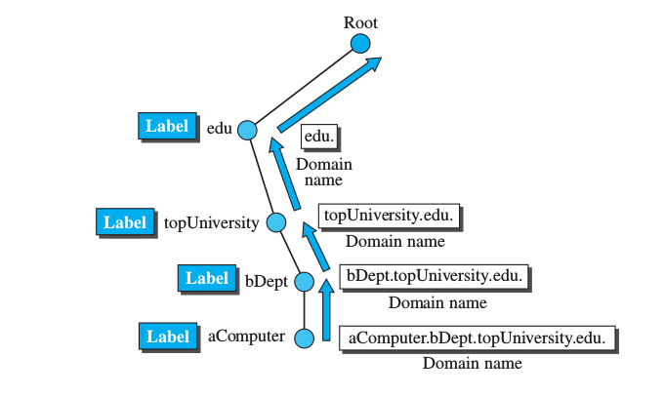
Domain Names and Labels

Slide 47
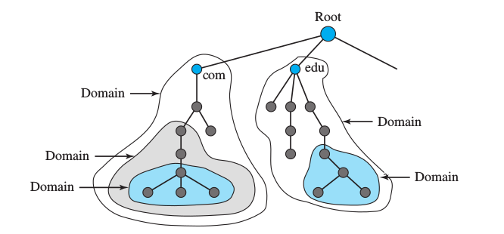
Domain

Slide 48
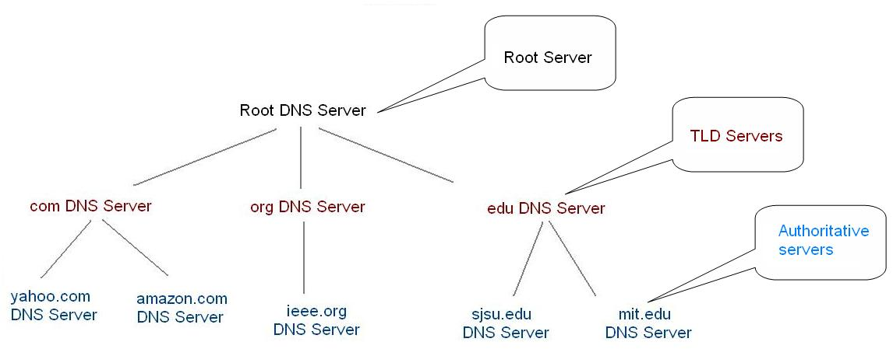
Hierarchy of Name Servers

Slide 49
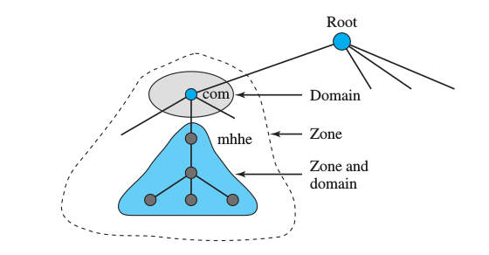
Zone:

Slide 50
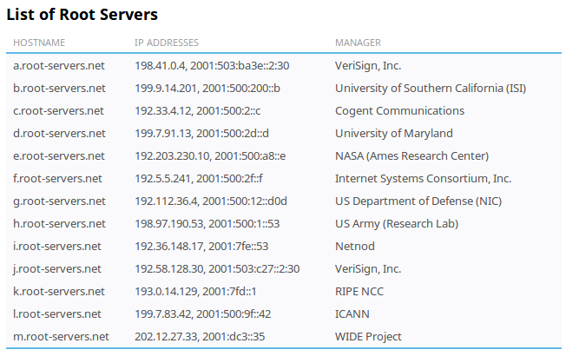
Ref: https://www.iana.org/domains/root/servers
For Root zone database : https://www.iana.org/domains/root/db
IANA: Internet Assigned Numbers
Authority

Slide 51
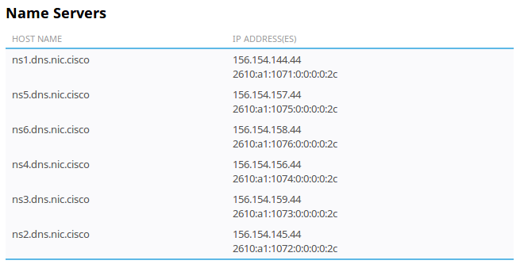
Primary and Secondary Name Servers
Ref : https://www.iana.org/domains/root/db/cisco.html

Slide 52
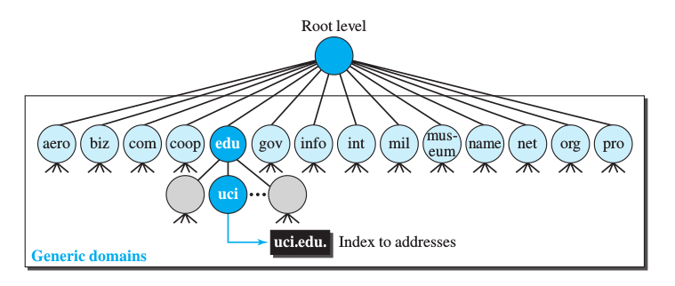
Generic Domains

Slide 53
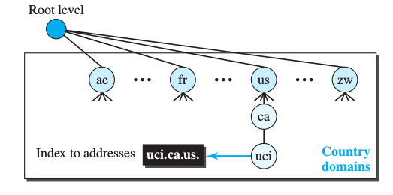
Country Domains

Slide 54
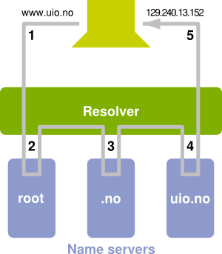
Resolution:

Slide 55
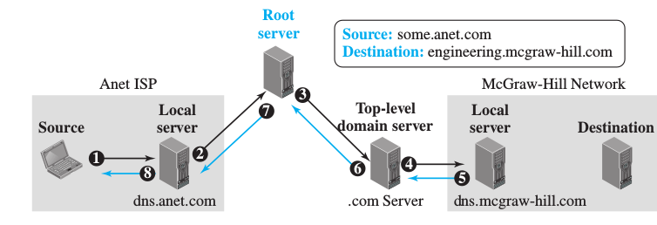
Recursive Resolution

Slide 56
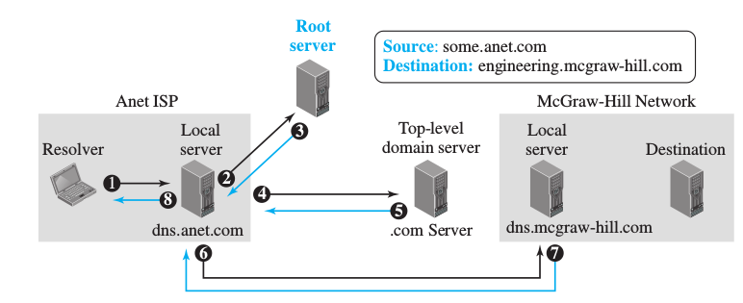
Iterative Resolution

Slide 57
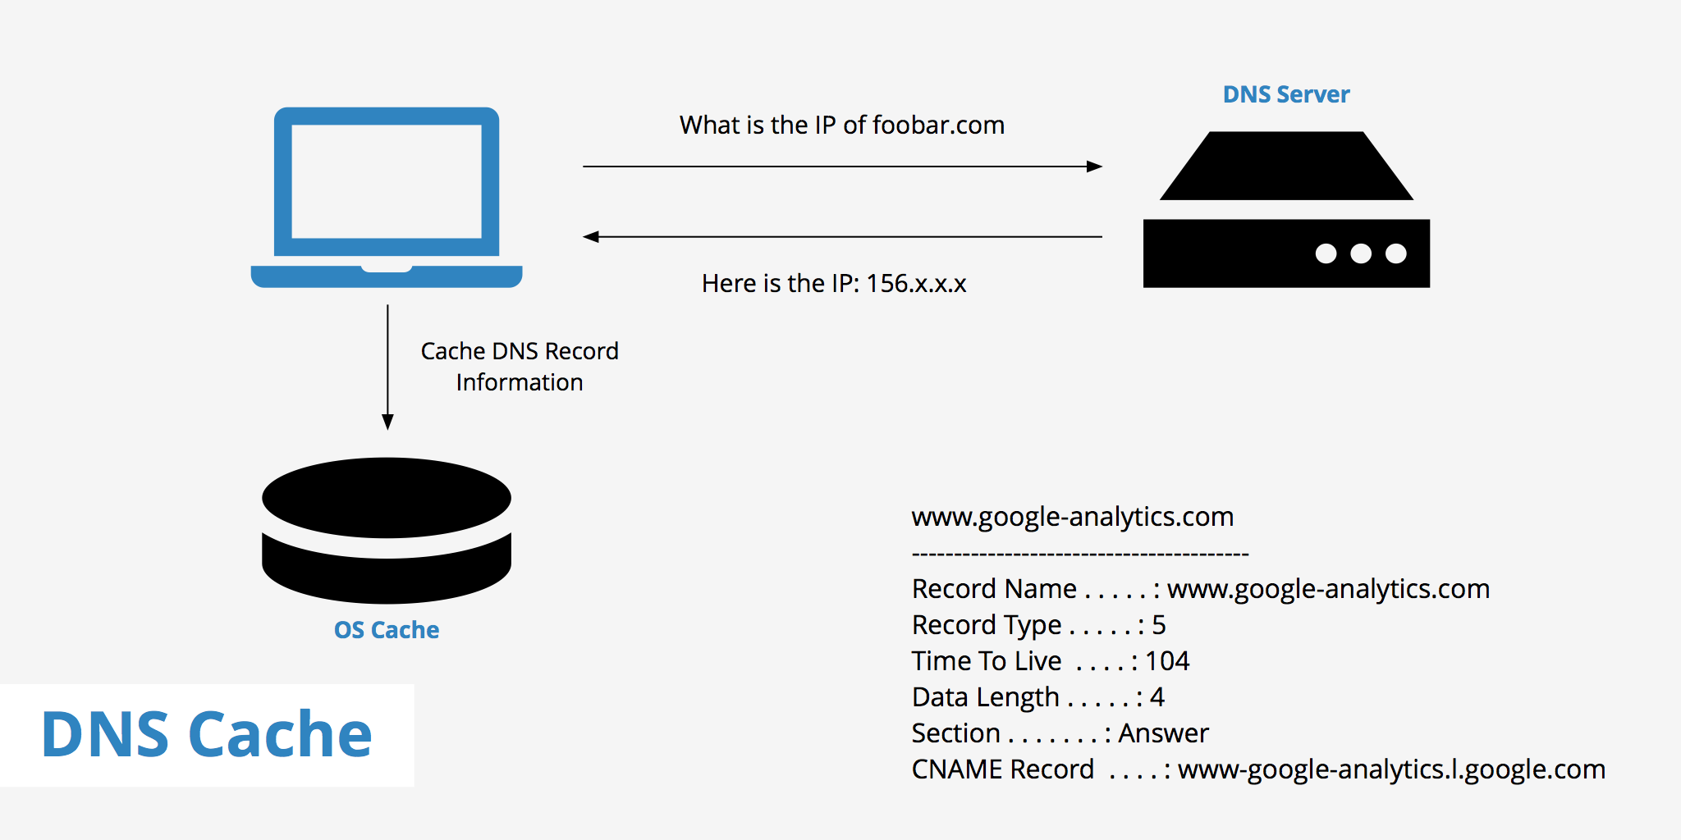
DNS Caching:

Slide 58

Domain Name Registration:

Slide 59
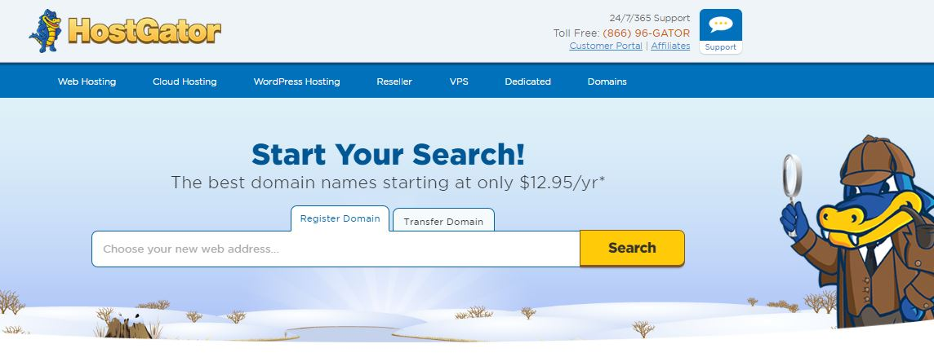

Registrars:
List of official registrars: https://www.icann.org/registrar-reports/accreditation-qualified-list.html

Slide 60
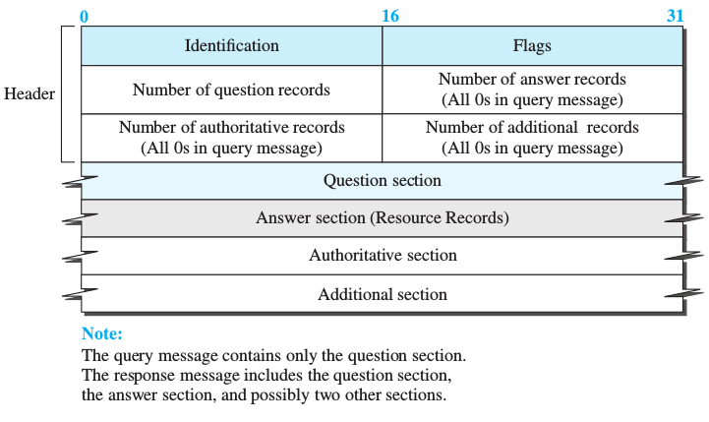
DNS Messages

Slide 61
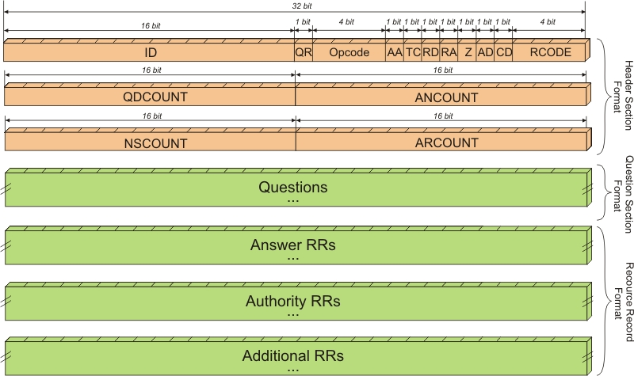
Detailed DNS Message:

Slide 62
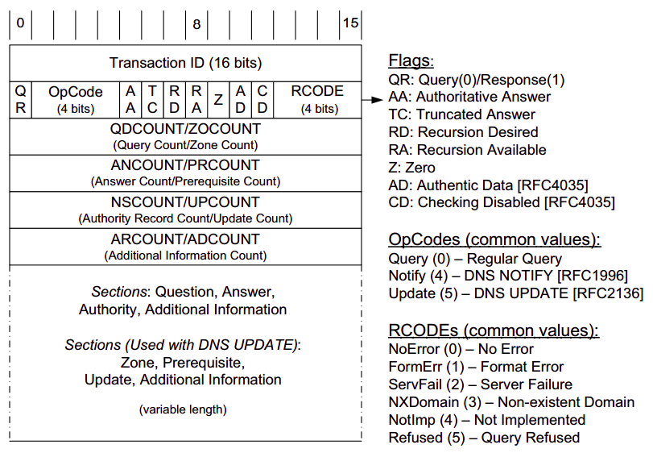

Slide 63
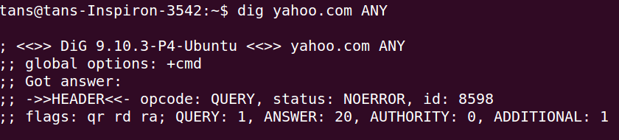
Example:

Slide 64
Resource Records
Resource record is a 5-tuple structure:
Ex:

Slide 65
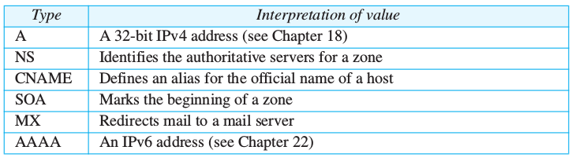
Record Types:

Slide 66
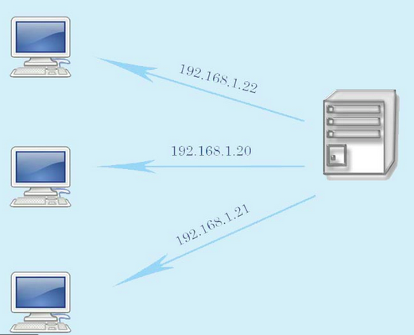
Dynamic Host Configuration Protocol
DHCP SERVER

Slide 67
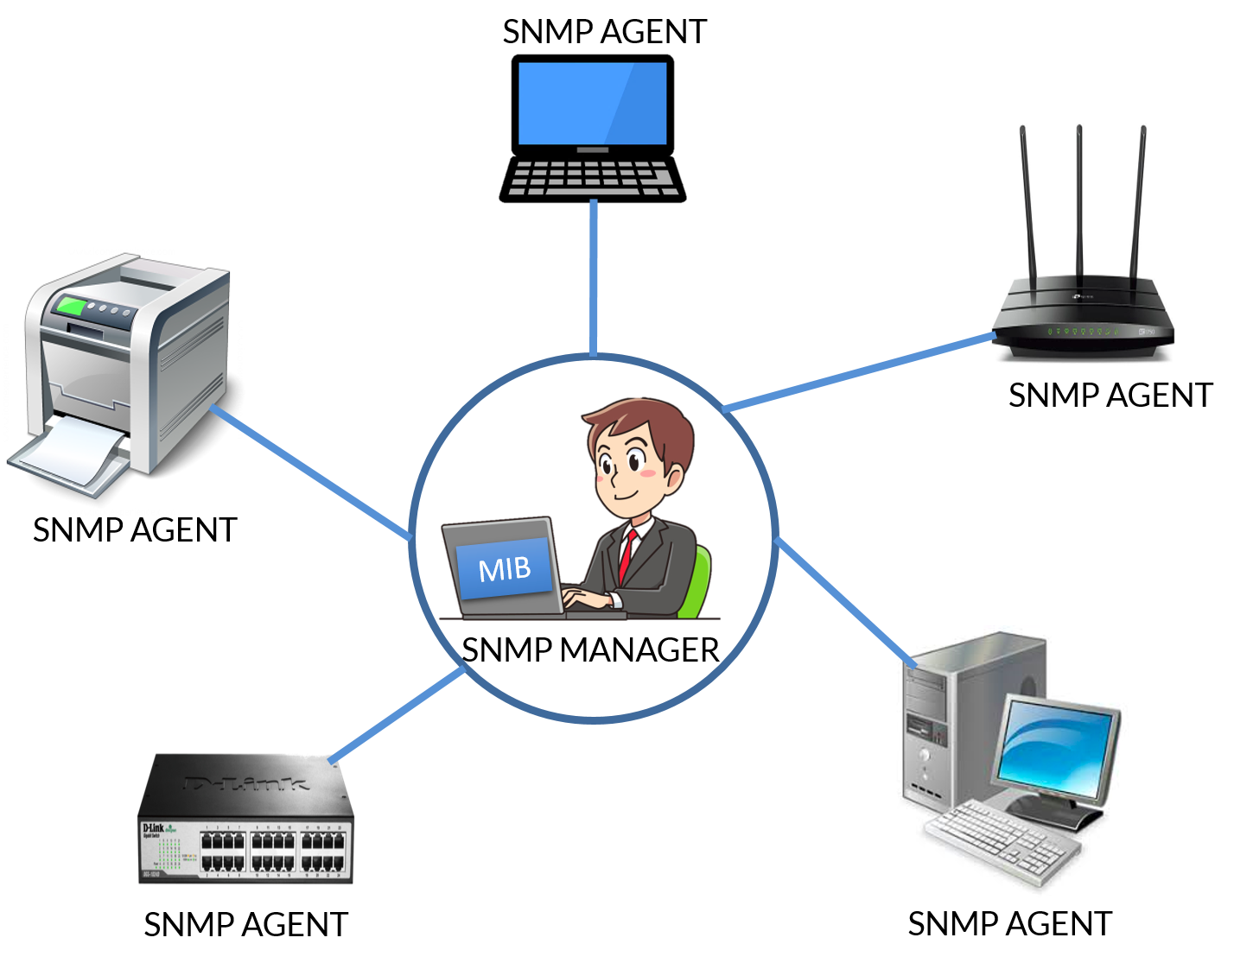
SNMP: Simple Network Management Protocol

Slide 68
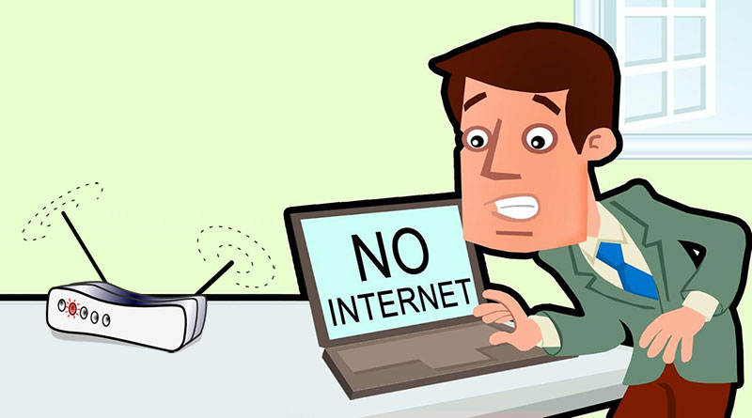
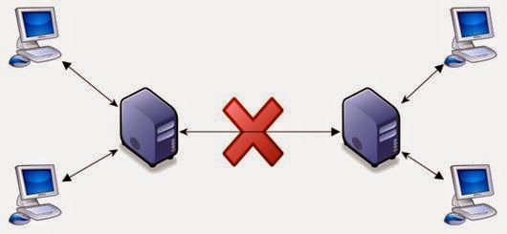

Importance of Network Management

Slide 69

Network Management:
Monitoring, testing, configuring, and troubleshooting network components to meet a set of requirements defined by an organization.
Goal is to achieve Quality of Service.

Slide 70
Configuration Management
Systems in a network may change their configuration.
Two subsystems:
Reconfiguration
Documentation
Reconfiguration:
Hardware reconfiguration: desktop replacement, subnetwork addition/removal.
Hard to Automate
Software reconfiguration: OS updation
Easily automated
User account reconfiguration: Manage user privileges
Automated to some extent

Slide 71
Configuration Management
Documentation:
Hardware Documentation
Maps
Specifications
Software Documentation
User Account Documentation

Slide 72
Next ?

Slide 73
Fault Management
Proper operation of network depends on proper operation of individual devices in the network.
Two subsystems:
Reactive Fault Management : Detecting, Isolating, Correcting, Recording of faults.
Proactive Fault Management : Prevent faults from occurring.

Slide 74
Performance Management

Slide 75
Performance Management
Monitor efficiency of the network.
Performance Measures:
Capacity
Traffic
Throughput
Response Time

Slide 76
Security Management

Slide 77


Security Management
AUTHENTICATION
ENCRYPTION

Slide 78
Accounting Management

Slide 79

Simple Network Management Protocol:
Framework for managing devices in TCP/IP network.
Provides operation for monitoring and maintaining the Internet.
Uses the concept of SNMP manager and agents.

Slide 80

SNMP:
Manager runs SNMP client program
Agents run SNMP server program
Keeps information in a database
Manager has access to the values in database
Agents can also help in network management
By sending warnings to the Manager about unusual conditions.
Three main protocols used in network management :
Structure of Management Information
Management Information Base

Slide 81
Role of SNMP:
Protocol to exchange information between between manager and agents.
Interpret results and create statistics.
Reads and changes values of objects in SNMP Packets

Slide 82
Role of SMI
SNMP makes use of objects, which is nothing but variables.
SNMP need rules for naming objects.
SMI defines general rules:
Naming objects
Defining object types
Way to encode objects and values

Slide 83
MIB
Creates a collection of named objects (as per the rules defined by SMI)
Defines number of objects
Associates type to each named object

Slide 84

Comparing with computer programming

Slide 85

Revisit:

Slide 86
SMI : Structure of Management Information
Is a guideline for SNMP
Main functions:
To name objects- Object ID, Tree Structure
To define the type of data that can be stored in an object.
To show how to encode data for transmission over the network.

Slide 87

SMI : Object Name
Real World Example:

Slide 88

SMI:

Slide 89

SMI:Type
Some of the types:

Slide 90

SMI: Encoding
SMI uses Basic Encoding Rules
Data to be transmitted is encoded with tag, length and value.
Example: Encoding Integer 14

Slide 91
MIB: Management Information Base
Contains Managed Objects ( Not related to OOP!)
Objects are variables
They represent resources of a system
Many standardized MIBs are available
MIB is a tree of objects (we already know this from SMI!)

Slide 92


Slide 94

MIB-2 Object

Slide 95

SNMP Requests:

